Slide 1

- Space System Design Concept -
Initial Reviews

Slide 2
ハイフライヤー
Haifuraiyā
Proposal Code Name: “High Flyer”

Slide 3
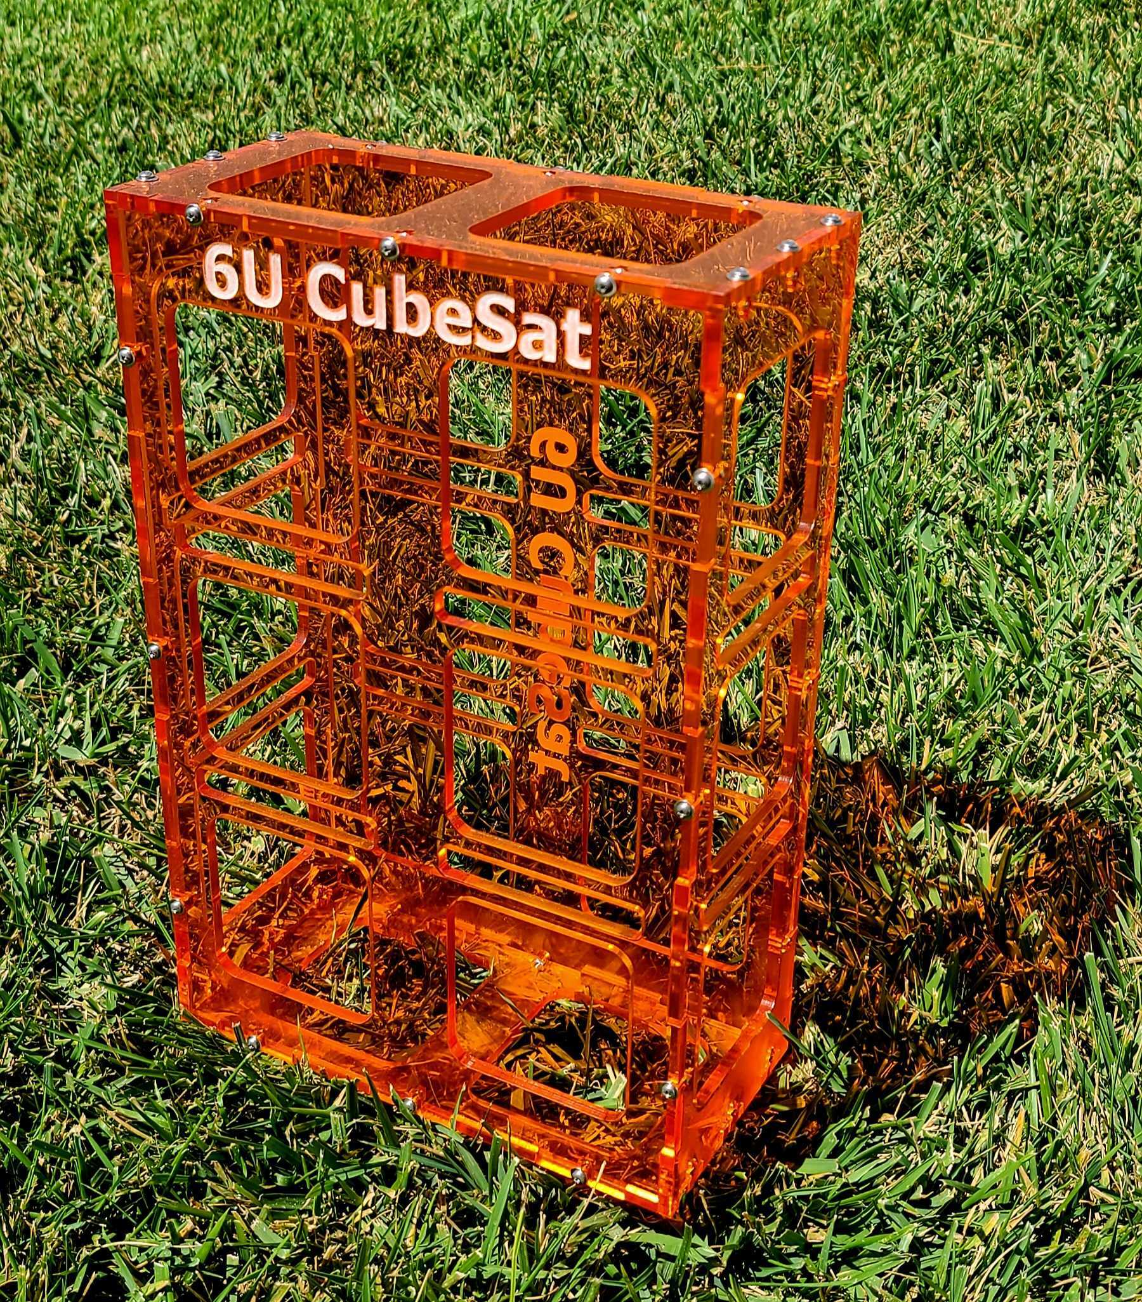
Mission Objectives
Deploy a useful digital communications resource for the amateur satellite service at HEO/GTO.
Demonstrate Open Source technologies that provide:
100 Simultaneous Voice Users
36,000 km Link
24 GHz Downlink; 10.5 GHz Uplink
Request to duplicate QO-100 frequencies to take advantage of the community and existing equipment.
5 GHz Uplink; 10.5 GHz Downlink
0.5 Meter Diameter User Ground Station Dish Antenna
< $1000 User Terminal Cost (Terminal Development is a Program Element)
Opportunity for small science payloads if proposal accepted.

Slide 4
Mission Objectives (2)
Demonstrate the ability of Electric Propulsion (EP) to carry out critical mission functions
Perigee raising after drop-off
Orbit circularization
Orbit adjustment
Mission disposal
Demonstrate the compatibility of digital communications with low-contamination Electric Propulsions System
Promote international goodwill and amateur technical education through Open Source design and development.

Slide 5
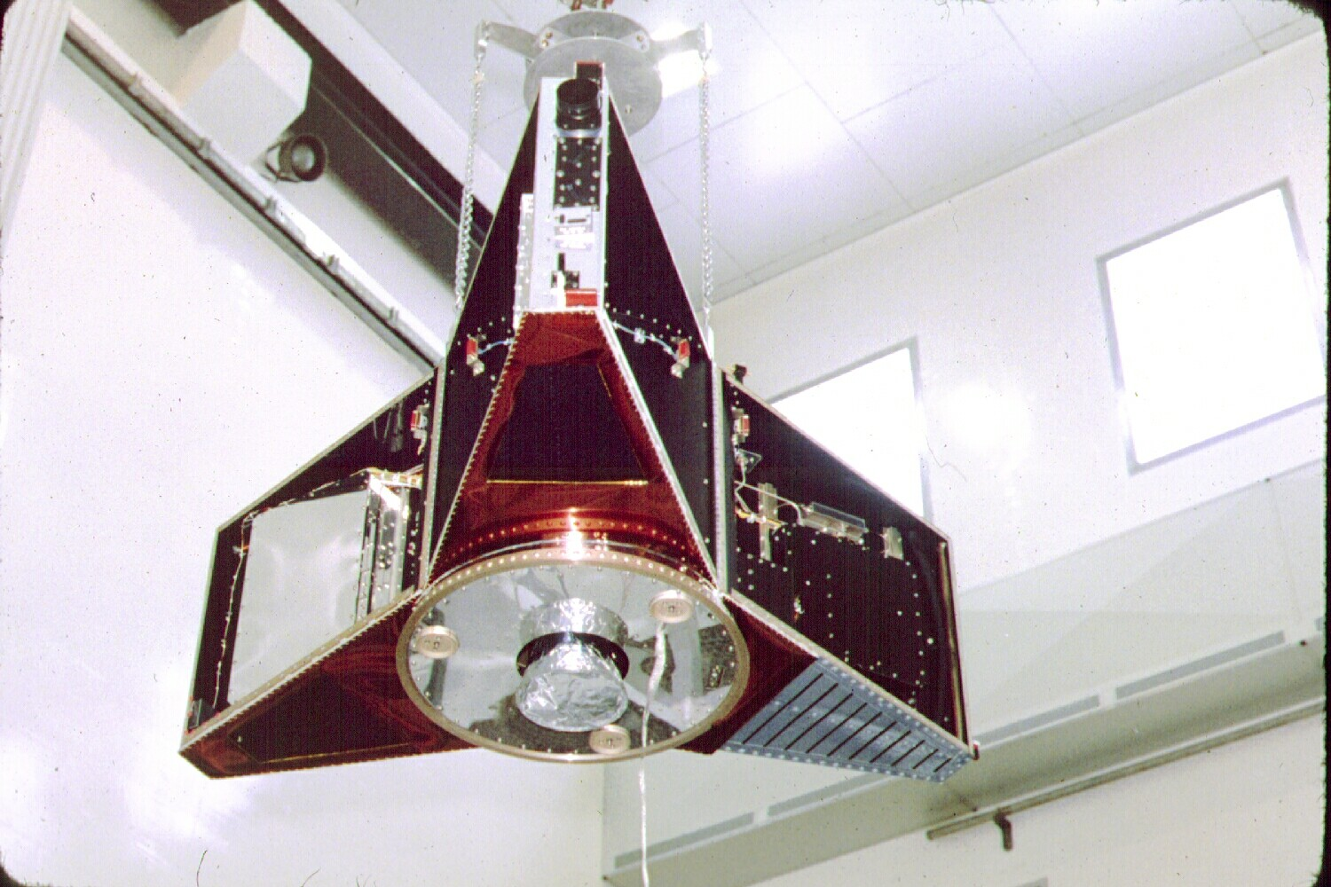
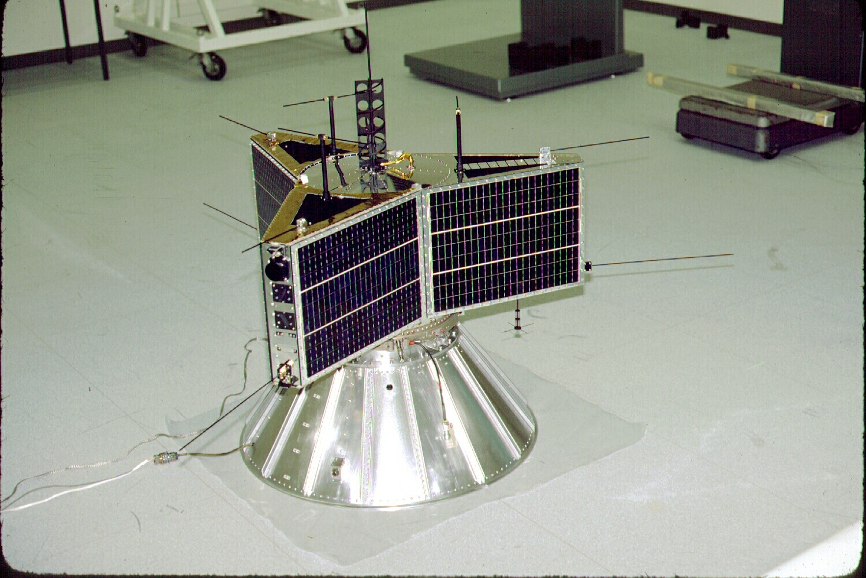
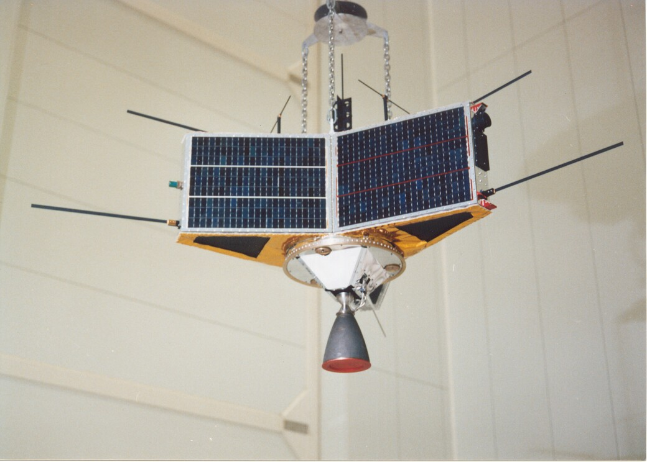
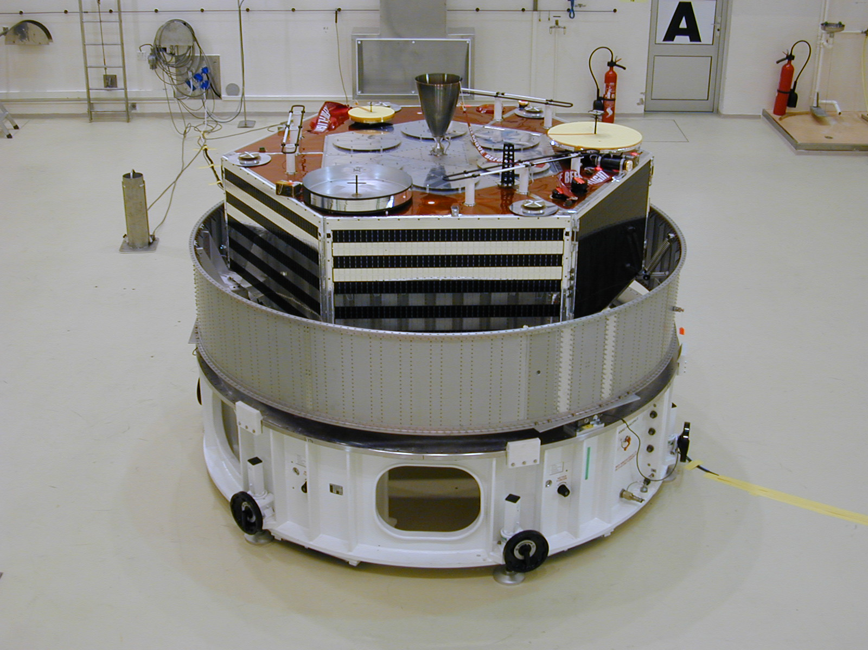
Prior AMSAT HEO Missions
AMSAT-Phase-3A
(1980 – Launch
Vehicle Failure)
AMSAT-OSCAR-10
(1983)
AMSAT-OSCAR-13
(1988)
AMSAT-OSCAR -40
(November 2000)
AO-40 Took 1 Decade
To Construct and Launch

Slide 6
Mission Orbit - Japan
Initial Orbit:
ha = 35,786 km
hp = 200 km
i = 7.0° to 51°
ω = 178°
Final Orbit:
ha = 35,786 km
hp = 1250 km
i = Unchanged
ω = 180°
Removal Orbit:
ha = 35,786 km
hp = 80 km
i = Unchanged
ω = unknown°
ΔV=31 m/sec
ΔV=
44 m/sec

Slide 7
Mission Orbit – North America
Initial Orbit:
ha = 35,786 km
hp = 200 km
i = 7.0° to 51°
ω = 178°
Final Orbit:
ha = 35,786 km
hp = 1250 km
i = Unchanged
ω = 180°
Removal Orbit:
ha = 35,786 km
hp = 80 km
i = Unchanged
ω = unknown°
ΔV=31 m/sec
ΔV=
44 m/sec

Slide 8
Spacecraft Physical Size
6U CubeSat Form Factor
Up to 1.1 kg per U kg mass (estimated)

Slide 9
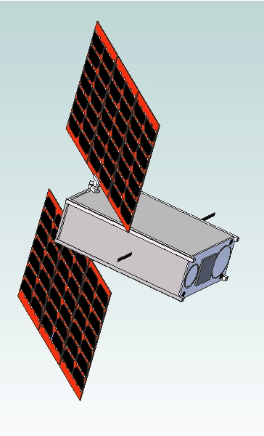
36-44 watt Light Weight Solar
Array; MMA Design, LLP
(typical of 2)
2014
Spacecraft
Configuration
Update the solar
Arrays side deploying,
Single hinge, several panels.
Sensor fusion
Possible,
Combining
Optical, spectral
Observations.
10.5 GHz Horn
(17.2 dBi Gain)
Solar Array
Drive
Mechanism
435 MHz
Omni
Antenna
1269 MHz
Omni
Antenna
1.270 GHz
Patch Antenna
24 GHz Horn
(20.0 dBi)

Slide 10
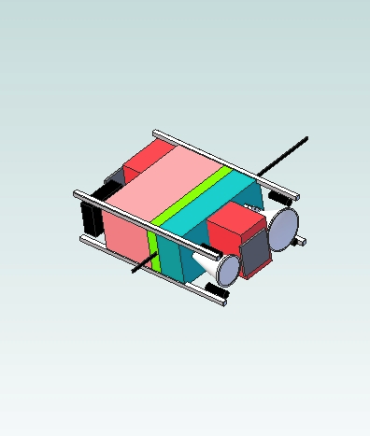
Spacecraft Internal Volume Allocation – no engines near comms
Vanderbilt Radiation Experiment
L/UHF Transponder +TLM +CMD
X-Ka (mmW) Transponder
Star Tracker
1269 MHz Monopole
Avionics (3 RWs, Flight Computer,
MPPTs, BCR, PDU)
μCAT PPT
(typ. of 4)

Slide 11
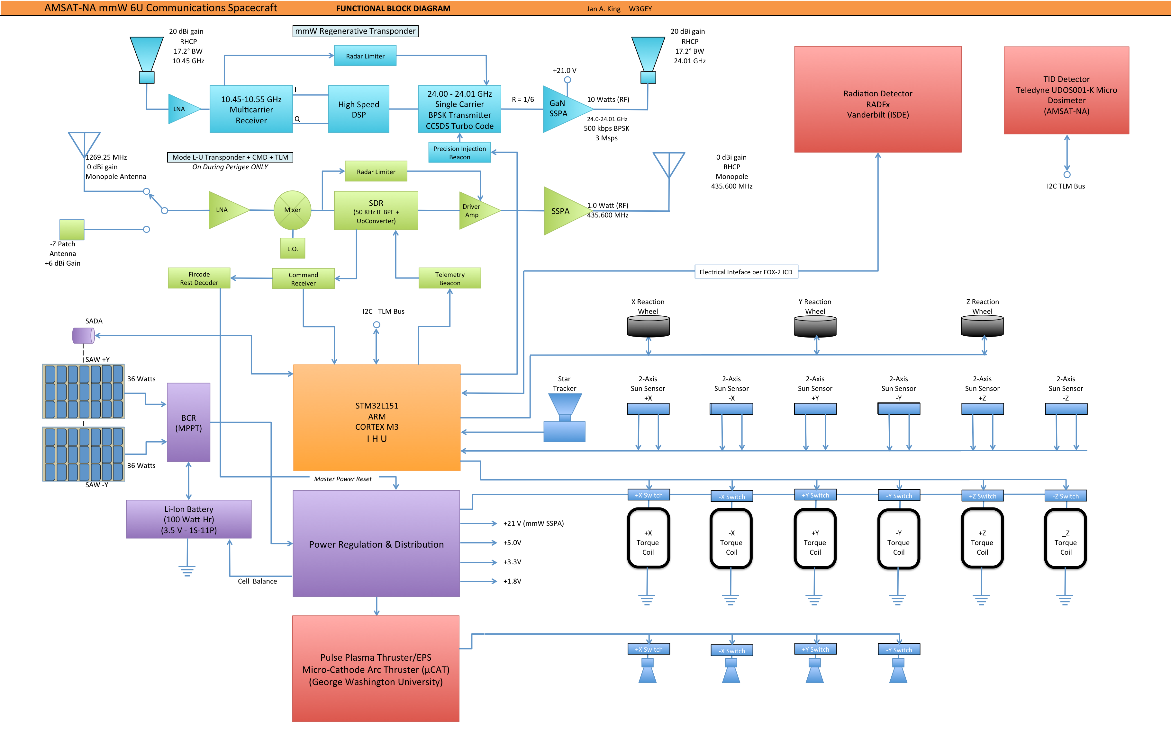
Spacecraft Functional Block Diagram Original

Slide 12
Spacecraft Functional Block Diagram Draft, Partial

Slide 13
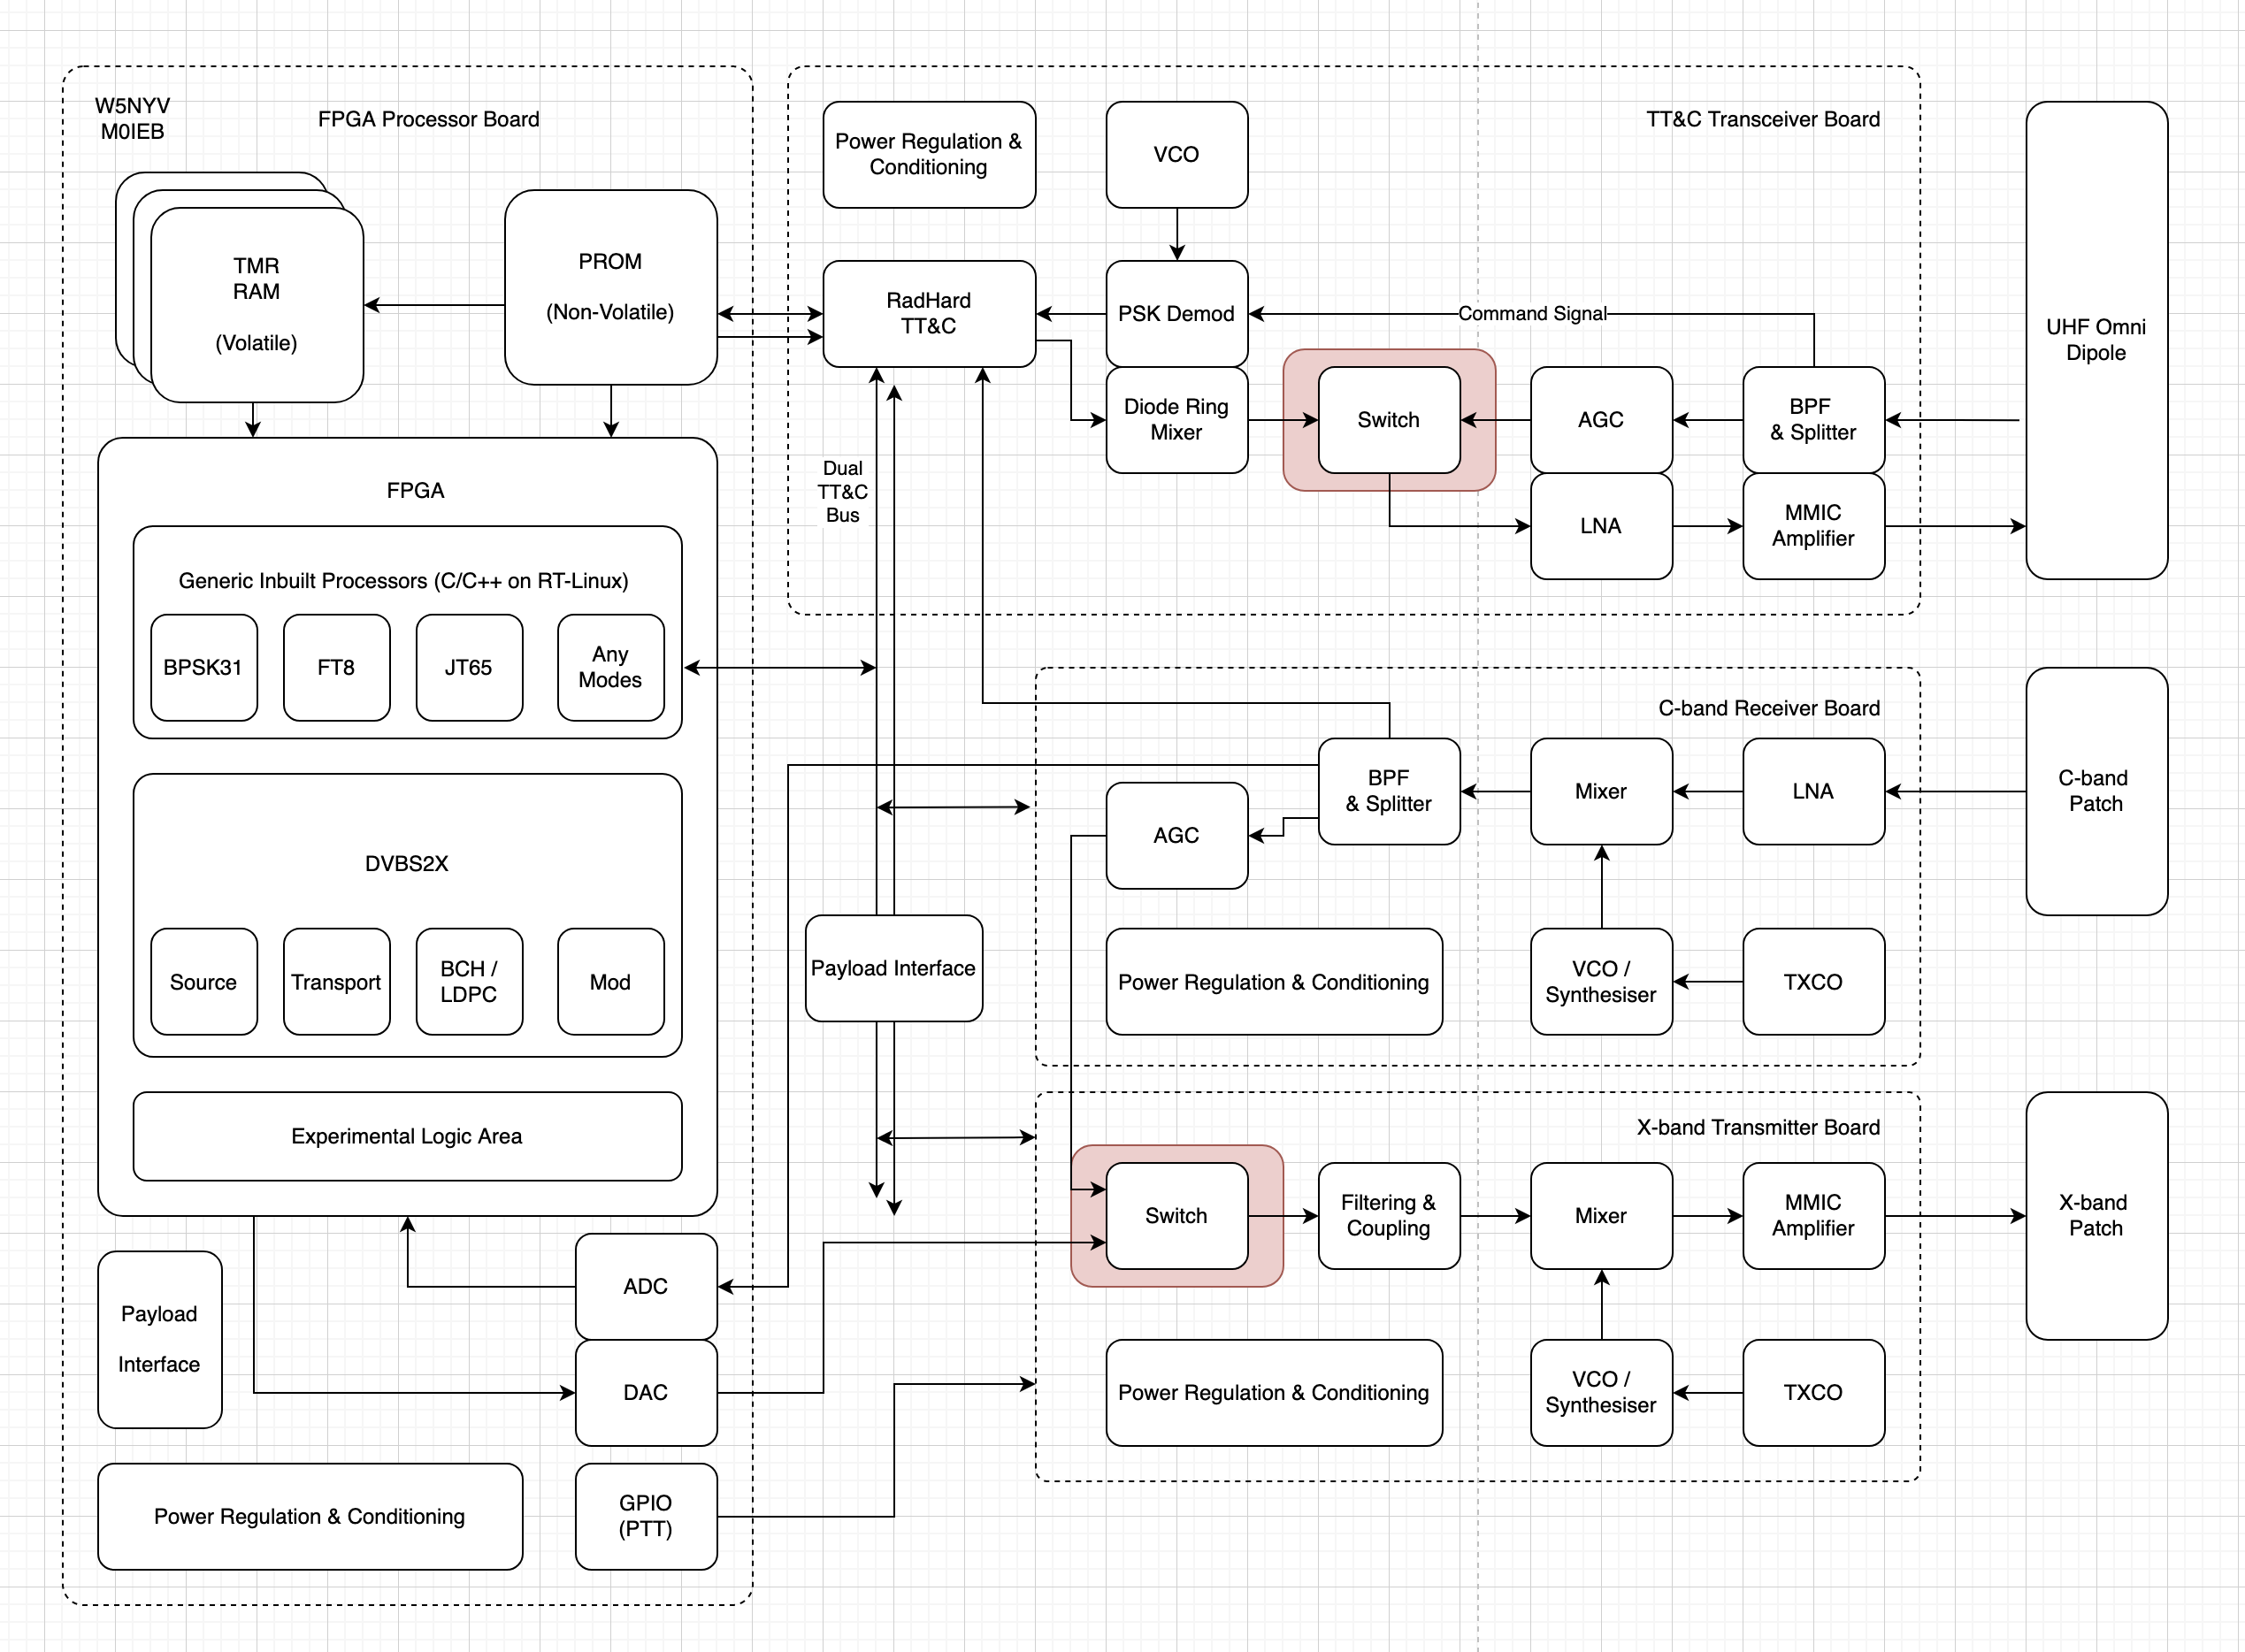
Spacecraft Functional Block Diagram Draft, Partial

Slide 14
Power Subsystem
Solar Arrays: MMA E-HaWK design; 72 watts average; 86 watts peak BOL; MPPT
Supercaps?
Compatibility with 28v (dirty power)
Batteries: Li-Ion; 2600 mAHr Each; 11P1S;
Capacity: 109 Watt-Hrs (3.5 V x 2.6 AHr x 12 Cells)
Driving Requirement is Worst Case Eclipse Heating (2 hour eclipse w. 10 watt heaters) = 20 watt-Hrs
Worst Case DoD: 18.3%
mmW Transponder Not Powered During Eclipse
L/UHF Transponder Powered During Nominal Eclipses but, not during W.C. Eclipses.
Loads Individually Switched: 3.3V, 5.0 V and 20 V (GaN SSPA)

Slide 15
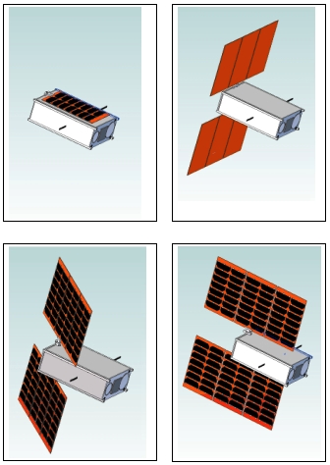
SOLAR
ARRAY
WINGS
(SAWs)
&
SADA
Solar Array Wings
(SAWs) – Two
MMA E-HaWK
Triple Deployment
Fits in 8.5 mm Stack
Peak Power: 86 W
Avg. Power: 72 W
TRL Level 9 by Flight
Single Axis SADA
Full 360° Control

Slide 16
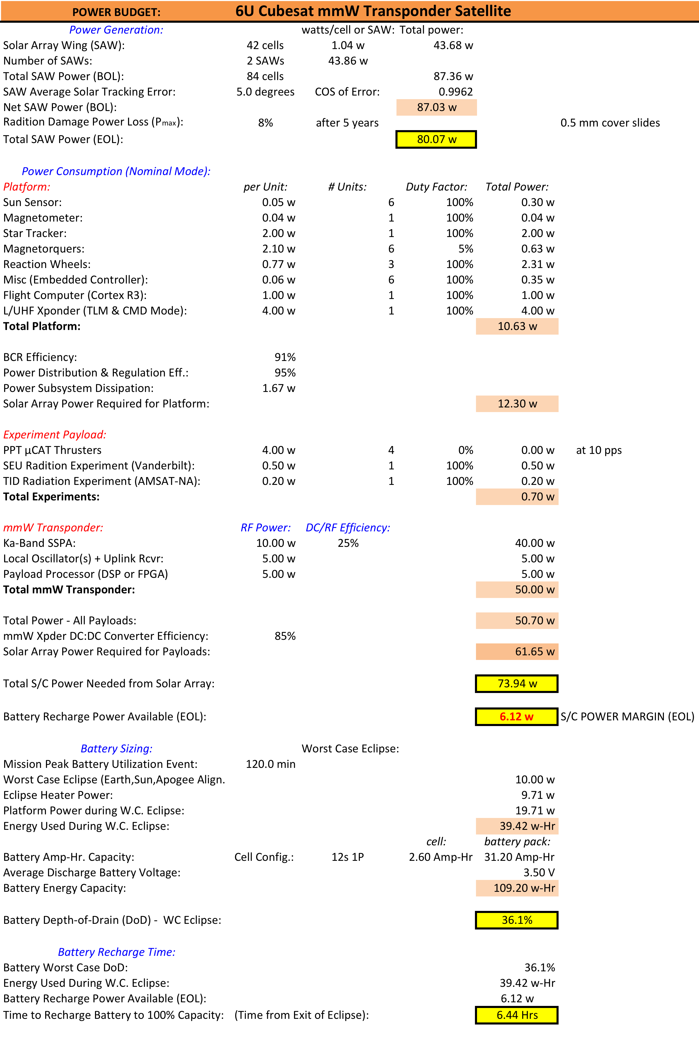
Power Budget

Slide 17
Structure Design (Basic Approach)
6U System is Volume Limited; Not Mass Limited (this may have changed)
Rigid (Thick) Exterior Wall Construction (this approach has changed)
Enclose things at a higher granularity. More open than original proposal.
Avionics Module Span Interior Volume between Walls adding Significant Additional Stiffness.
Recent Vibration Testing on a Similar 6U demonstrated a First Mode Resonant Frequency >1000 Hz

Slide 18
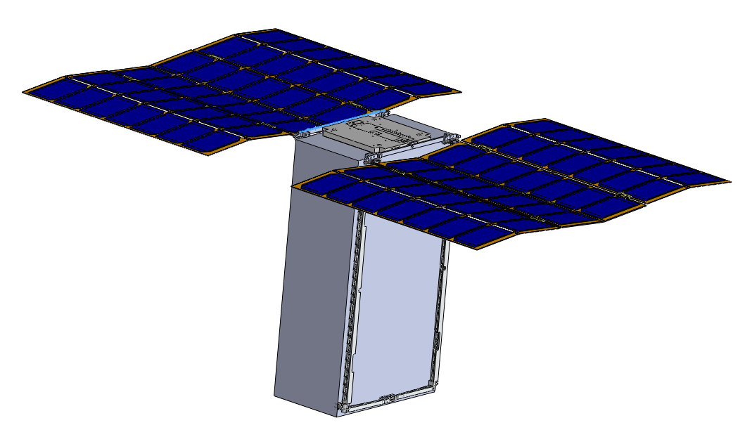
Structure Design (2)
P-POD Guide rails are formed
by the mechanical frame which
also holds and secures the
folded SAWs. Arrays fold
within an 8.5 mm packing
height.
TWO FOR THE PRICE OF ONE FRAME.
3D CAD Courtesy MMA Design, LLC

Slide 19
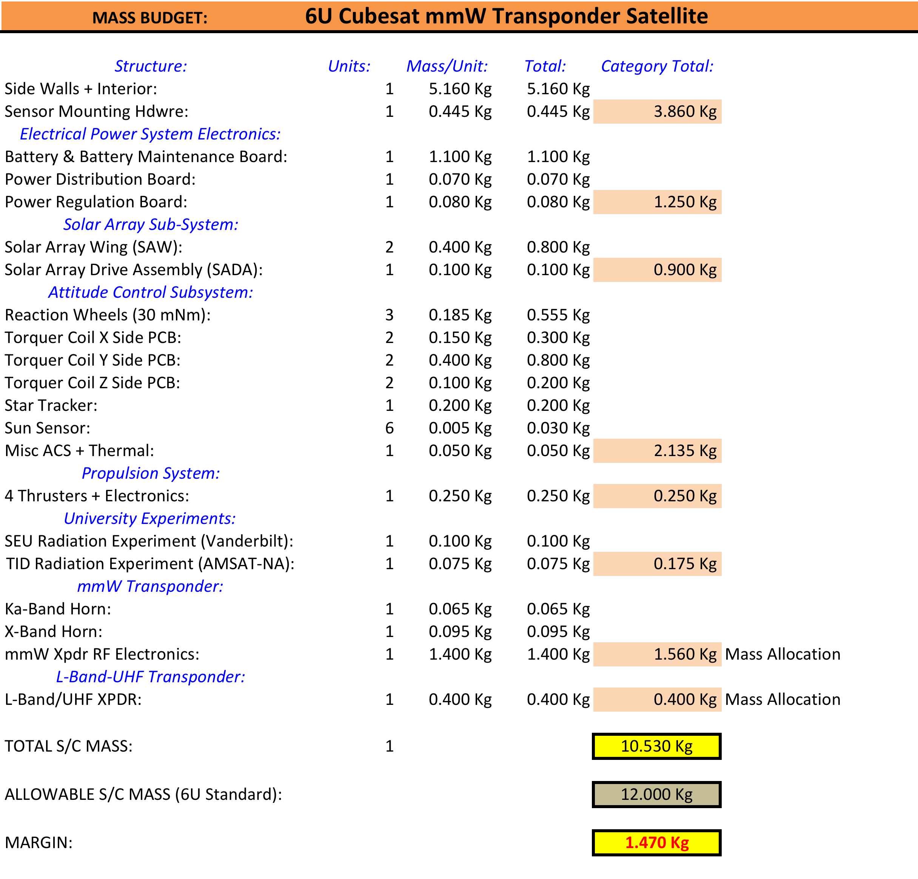
Mass Budget

Slide 20
Thermal Design

Slide 21
Attitude Control System
3-Axis Attitude Control System
Requirements:
Accuracy & Knowledge:
P: ± 1.0° (driven by Ka-Band antenna beam)
R: ± 1.0° (driven by Ka-Band antenna beam)
Y: ± 5.0° (driven by Solar Array Drive requirements
NADIR Pointing Mode (with varying Earth size): ± 1.0°
Safe Hold Mode: Return SADA to 0°; Spin about Y; Sun in XY Plane
Point-on-Earth Target Tracking Mode (Optional)
Maintain Solar Array Axis (Y) Normal to Sun at all Times
Control SADA to Maintain Cells Normal to Sun (Full Power)
Momentum Dumping Scheme at Perigee

Slide 22
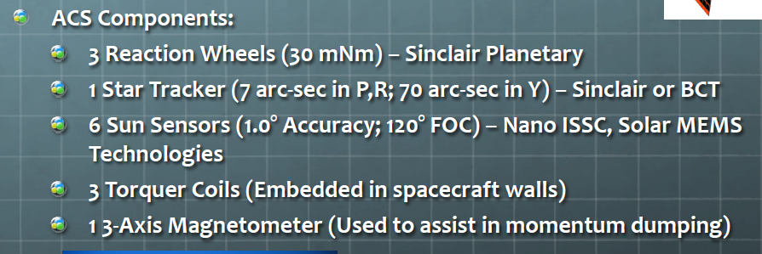
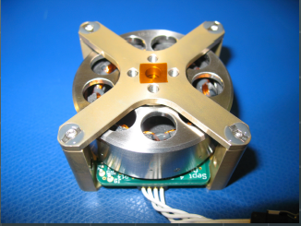
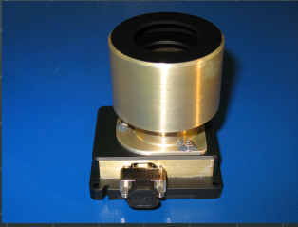
Attitude Control System (2) (Update the components)
Sinclair
RW
Sinclair
Star Tracker

Slide 23
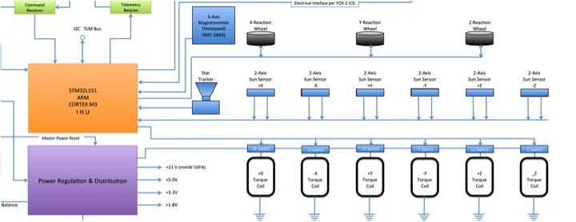
Attitude Control System (3) (Component Interfaces) add desaturation by EP

Slide 24
Attitude Control System (4) (Operating Modes)
Set SADA = 0°; Spin about Y; Sun in XZ Plane
Safe-Hold
Mode
De-Tumble
Mode
NADIR Pointing
Mode
Commanded Earth Target ±1°
Earth Target Tracking
Mode
Propulsion
Mode
Earth Center ±1°
At Apogee; Ram or Wake ±1°
(Optional)
November 13, 2014
HEO-F Overview
25

Slide 25
Flight Computer (IHU) (Has Flight Heritage from FOX Program)
STMicroelectronics STM32L151VBT6
ARM3 Cortex CPU (32-bit)
Up to 33 MIPS @32 MHz
Designed for ultra low power consumption
128K FLASH program memory
16K RAM (Will Likely Need More RAM)
Built-in timers, RTC, D/A, A/D, serial IO

Slide 26
Primary Experiment - mmW Regenerative Transponder -
10.45-10.50 GHz Amateur Band Currently Actively In Use – Makes a Good Uplink Band. Many Transmitters are Available.
24.00-24.05 GHz Amateur Band not Used Very Much – Will Make a Good Downlink Band
But, 24 GHz is nearly ON the first Water Absorption Line.
This makes transmitting on this frequency much more interesting as it allows us to “see” weather with our transponder.
24 GHz allows us to showcase ACM adaptive coding and modulation.

Slide 27
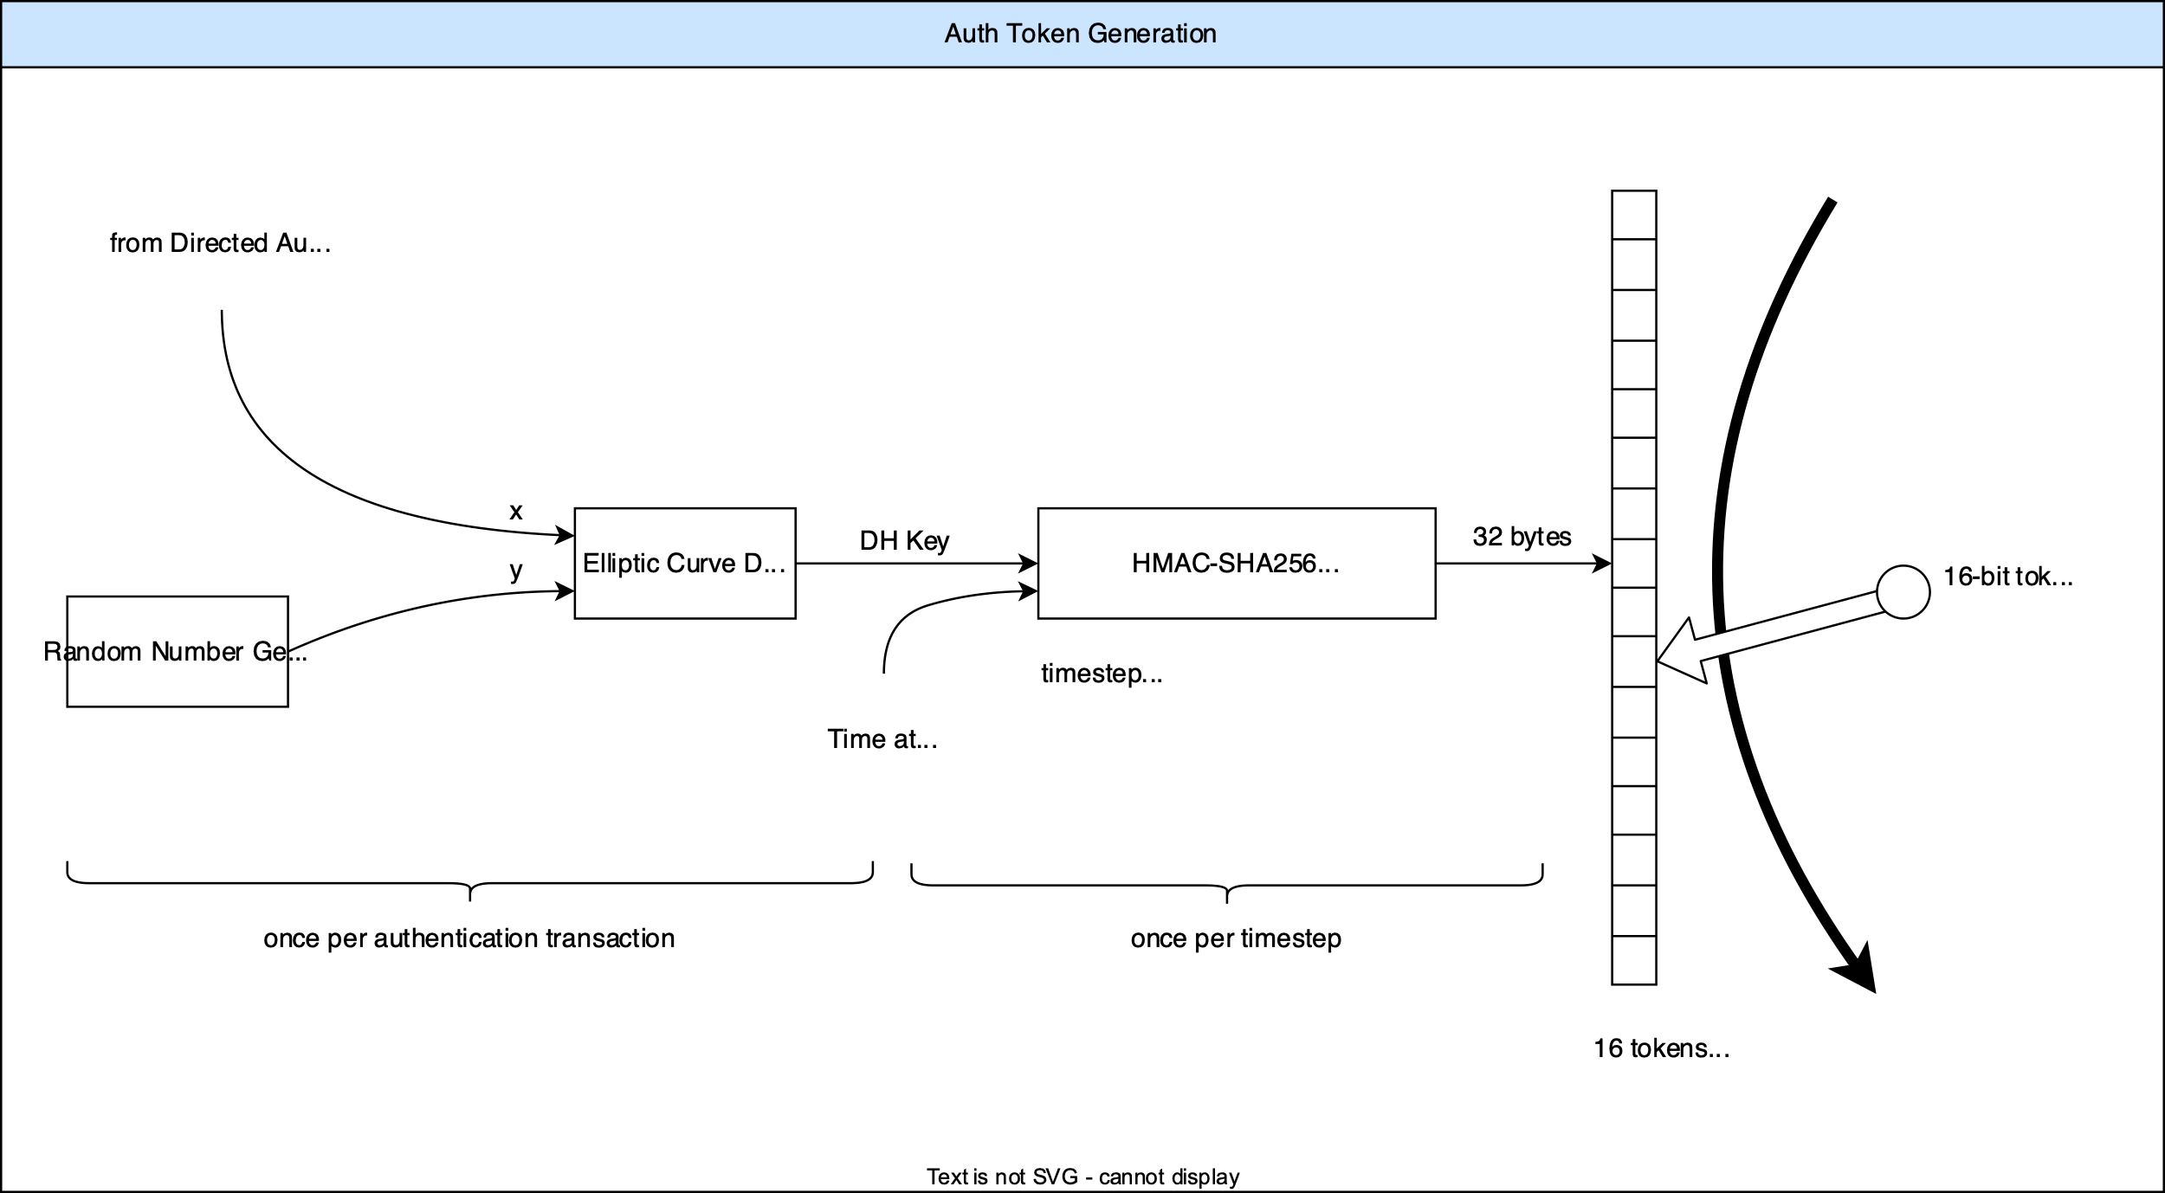
Authentication and Authorization

Slide 28
Primary Experiment mmW Regenerative Transponder (2)
Horn Beamwdith ≈ Earth Coverage
10.5 GHz Horn (17 dBi)
24 GHz Horn (20 dBi)
10.45-10.50 GHz
Multicarrier
RX
High Speed
ADCs
Fast DSP
Of
FPGA
Single Carrier
BPSK 24 GHz TX
+ Turbo Code Encoder
Uplink:
100 Users; Contention Based FDMA
Users Select Frequency Randomly
Conflicted Users Retry on Random Freq.
User TX is 2.0 watts
User Antenna is 1 meter dish
50cm or less goal
FEC on Uplink: R=1/2 Sequential + RS
Spectral Efficiency ≈ 0.5 bit/Hz
User Rate = 5000 bps = 10 kHz
Uplink RX FFT Used to Find Each User within ms, capable of 100 sequential acquisitions..
Downlink: 10 W GaN 24 GHz SSPA
Uplink data streams aggregated into
a single downlink bit stream.
100 Users x 5,000 bps = 0.5 Mbps D.R.
Downlink Heavily Coded: R=1/6 Turbocode
Modulation is surpressed carrier BPSK
Symbol Rate = 3Msps
Bandwidth approximately 7.5 MHz
Each User Can Decode Any 5 kbps
Bit Stream
Primary User Interface is OPUS Vocoder

Slide 29
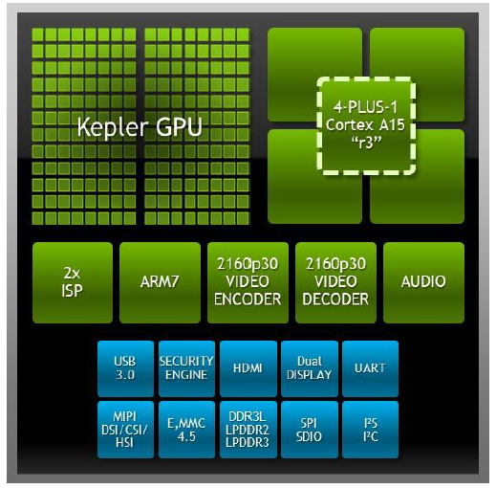
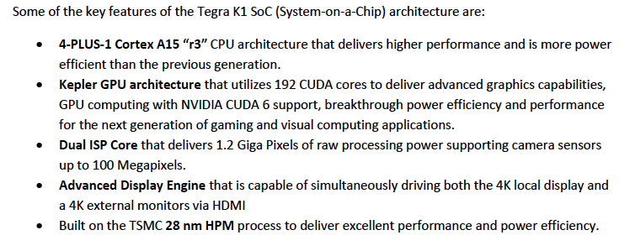
Primary Experiment mmW Regenerative Transponder (3) Uplink Signal Processor (How Do We Know It Can Be Done?)
NVIDIA Tegra K1 GPU

Slide 30
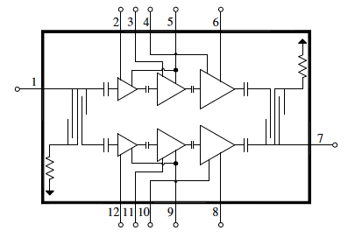
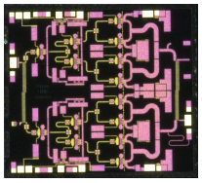
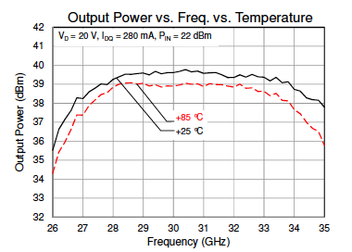
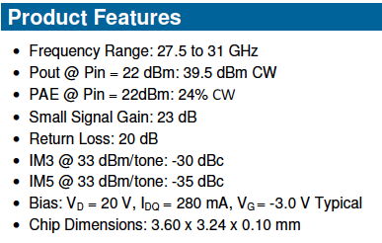
Primary Experiment mmW Regenerative Transponder (4) 24 GHz GaN SSPA (How Do We Know It Can Be Done?)
27.5 - 31 GHz 9W Power Amplifier
TRIQUINT
Part # TGA2595

Slide 31
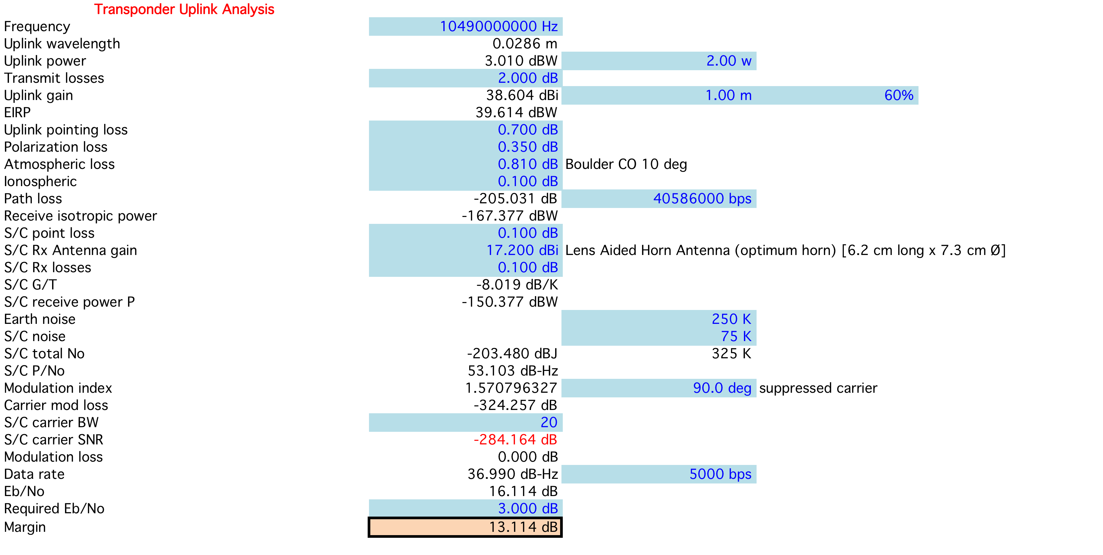
mmW Transponder Uplink (Reference)
Ref: Boulder, CO @ 10° Elev. Angle; Clouds, No Rain

Slide 32
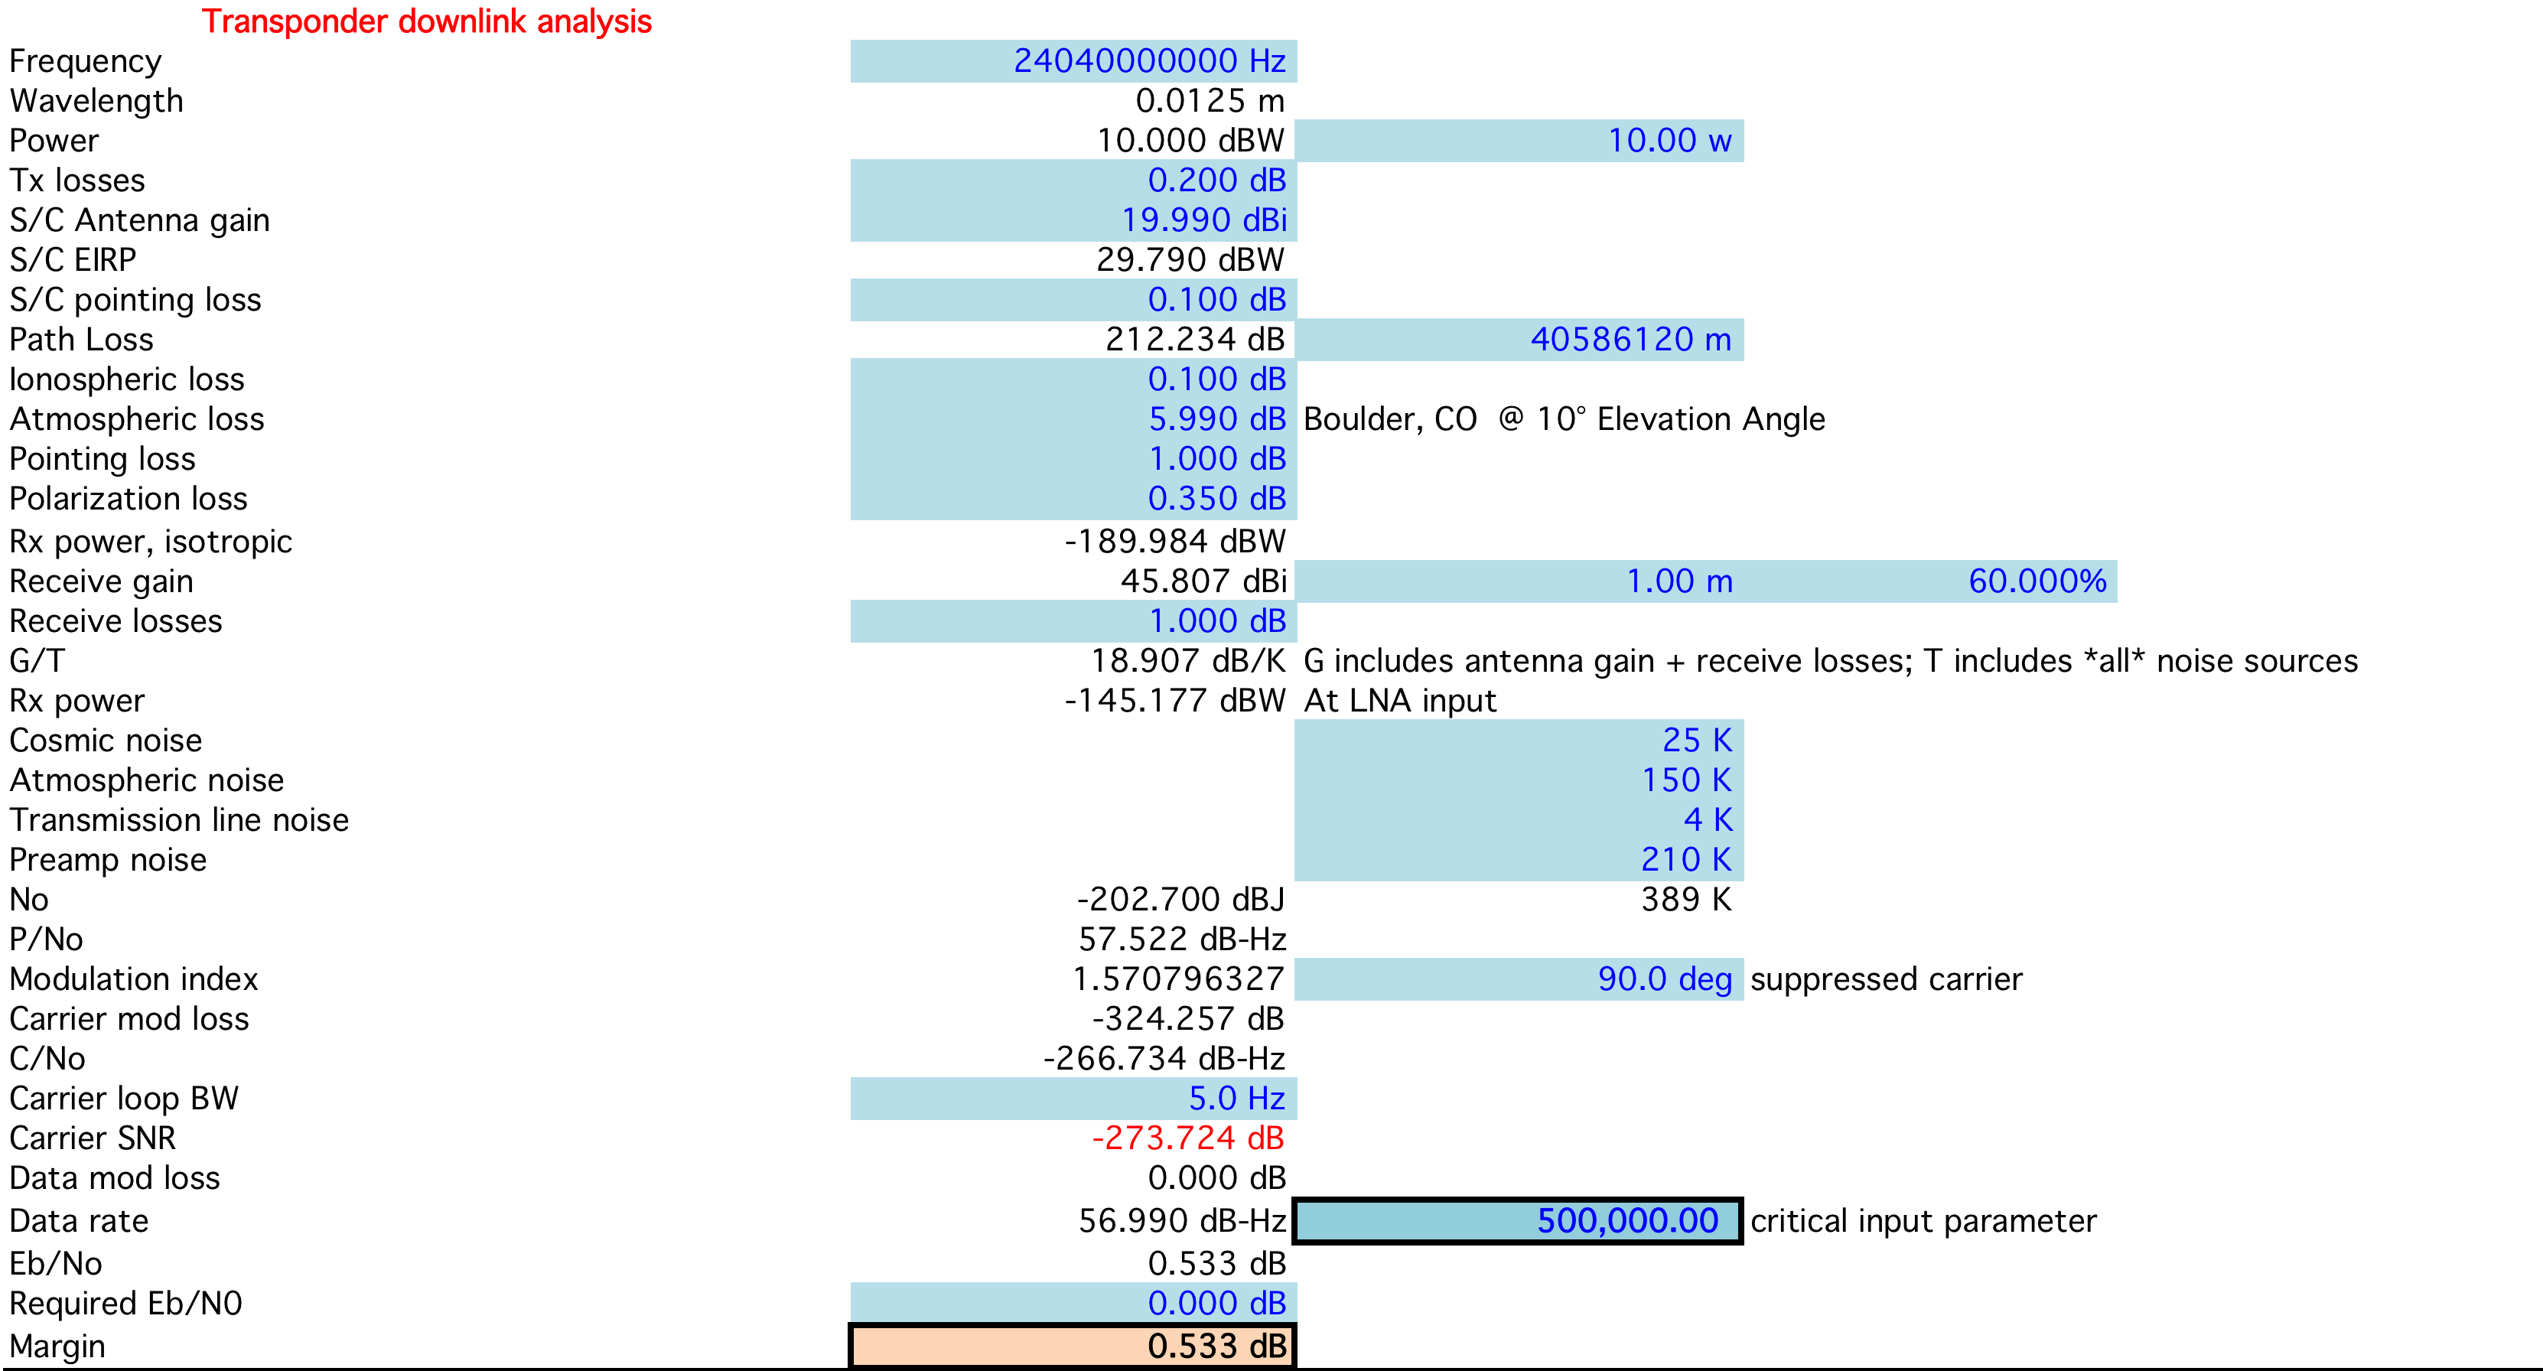
mmW Transponder Downlink (Reference)
Ref: Boulder, CO @ 10° Elev. Angle; Clouds, No Rain
100 Users @ 5.0 kbps each

Slide 33
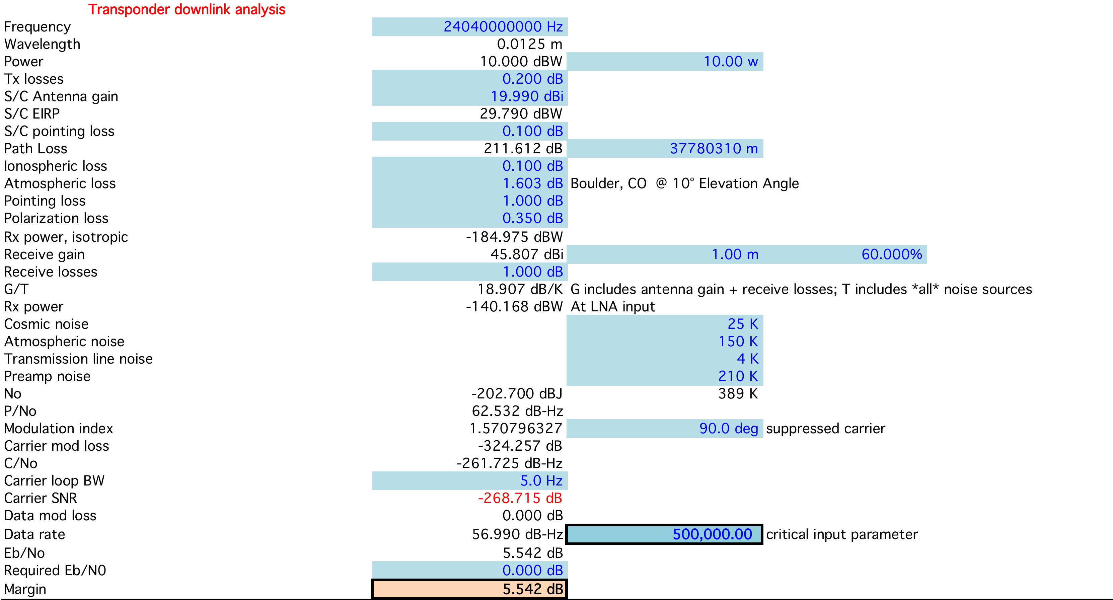
mmW Transponder Downlink (Typical Conditions)
Ref: Boulder, CO @ 40° Elev. Angle; Clouds, No Rain
100 Users @ 5.0 kbps each

Slide 34
T & C; L-to-U Transponder (?) Possibly new frequencies for T&C Less cosmic noise
UHF Telemetry Downlink (On XPDR Subcarrier)
9600 BPSK (Carrier Suppressed)
Required TLM G.S. Gain: 17.1 dBi (e.g. Standard Yagi Antenna)
L-band Command Uplink (On Uplink Sub-band)
Required Uplink Power for CMD: 25 watts
Required CMD G.S. Antenna Gain: 17.1 dBi (e.g. one M² Yagi)
Link Margin at Apogee: >6 dB both directions
R=1/2 Sequential (e.g. Viterbi ) + Block Code (e.g., RS) Used [Both Links]

Slide 35
L-Band to UHF Transponder
Active Below 5000 Km Altitude (Thru Perigee Typical)
Monopole on TX (shared with TLM subcarrier)
Uplink (Patch for NADIR Use and Monople Otherwise)
T&C Active at All Times
UHF SSPA: ≥ 1.0 watts
L-Band LNA: ≤ 1.0 dB NF (75 K) 225K system N.T.
User Passband: 40 to 50 KHz
T & C; L-to-U Transponder
TLM Subcarrier at -10dB while XPDR is on
Beacon
Transponder Passband

Slide 36
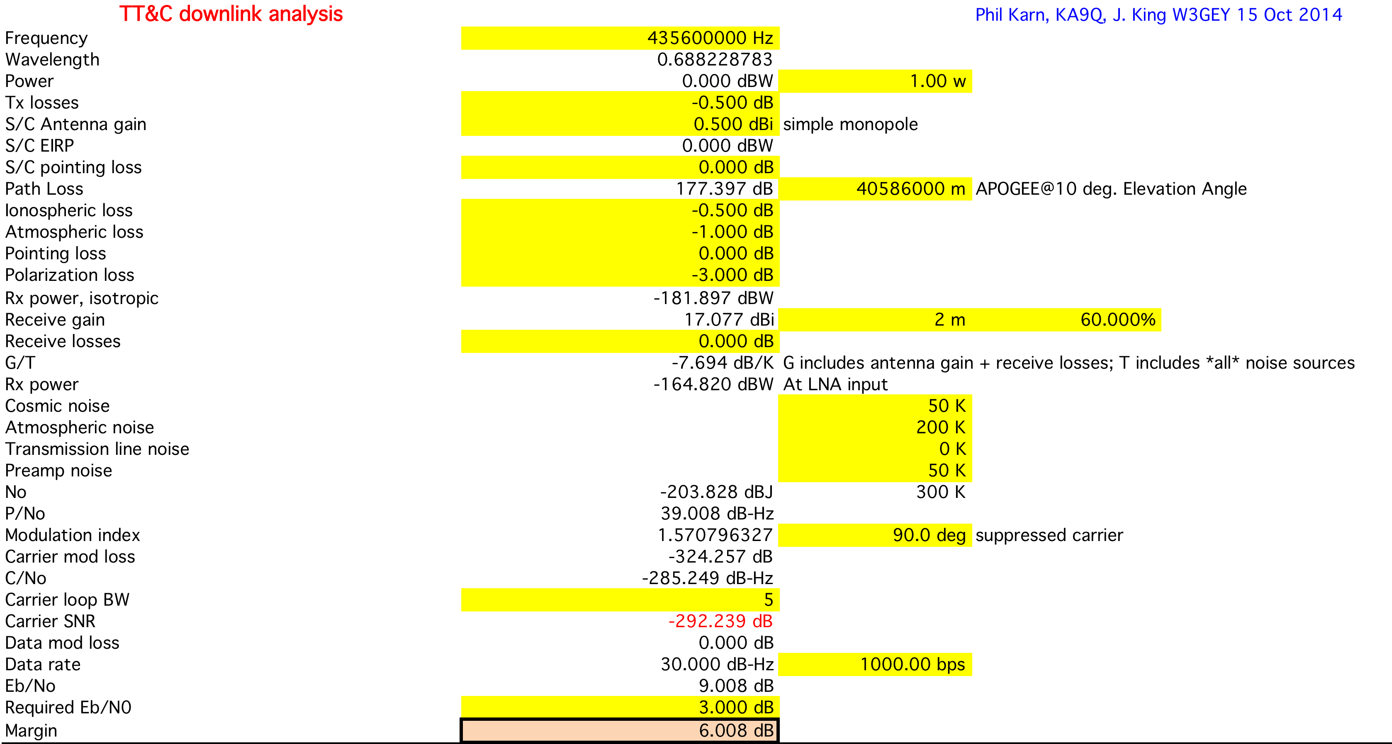
TLM Link Budget
(@Apogee; Elevgle = 10°)
Circularly Polarized Yagi
C

Slide 37
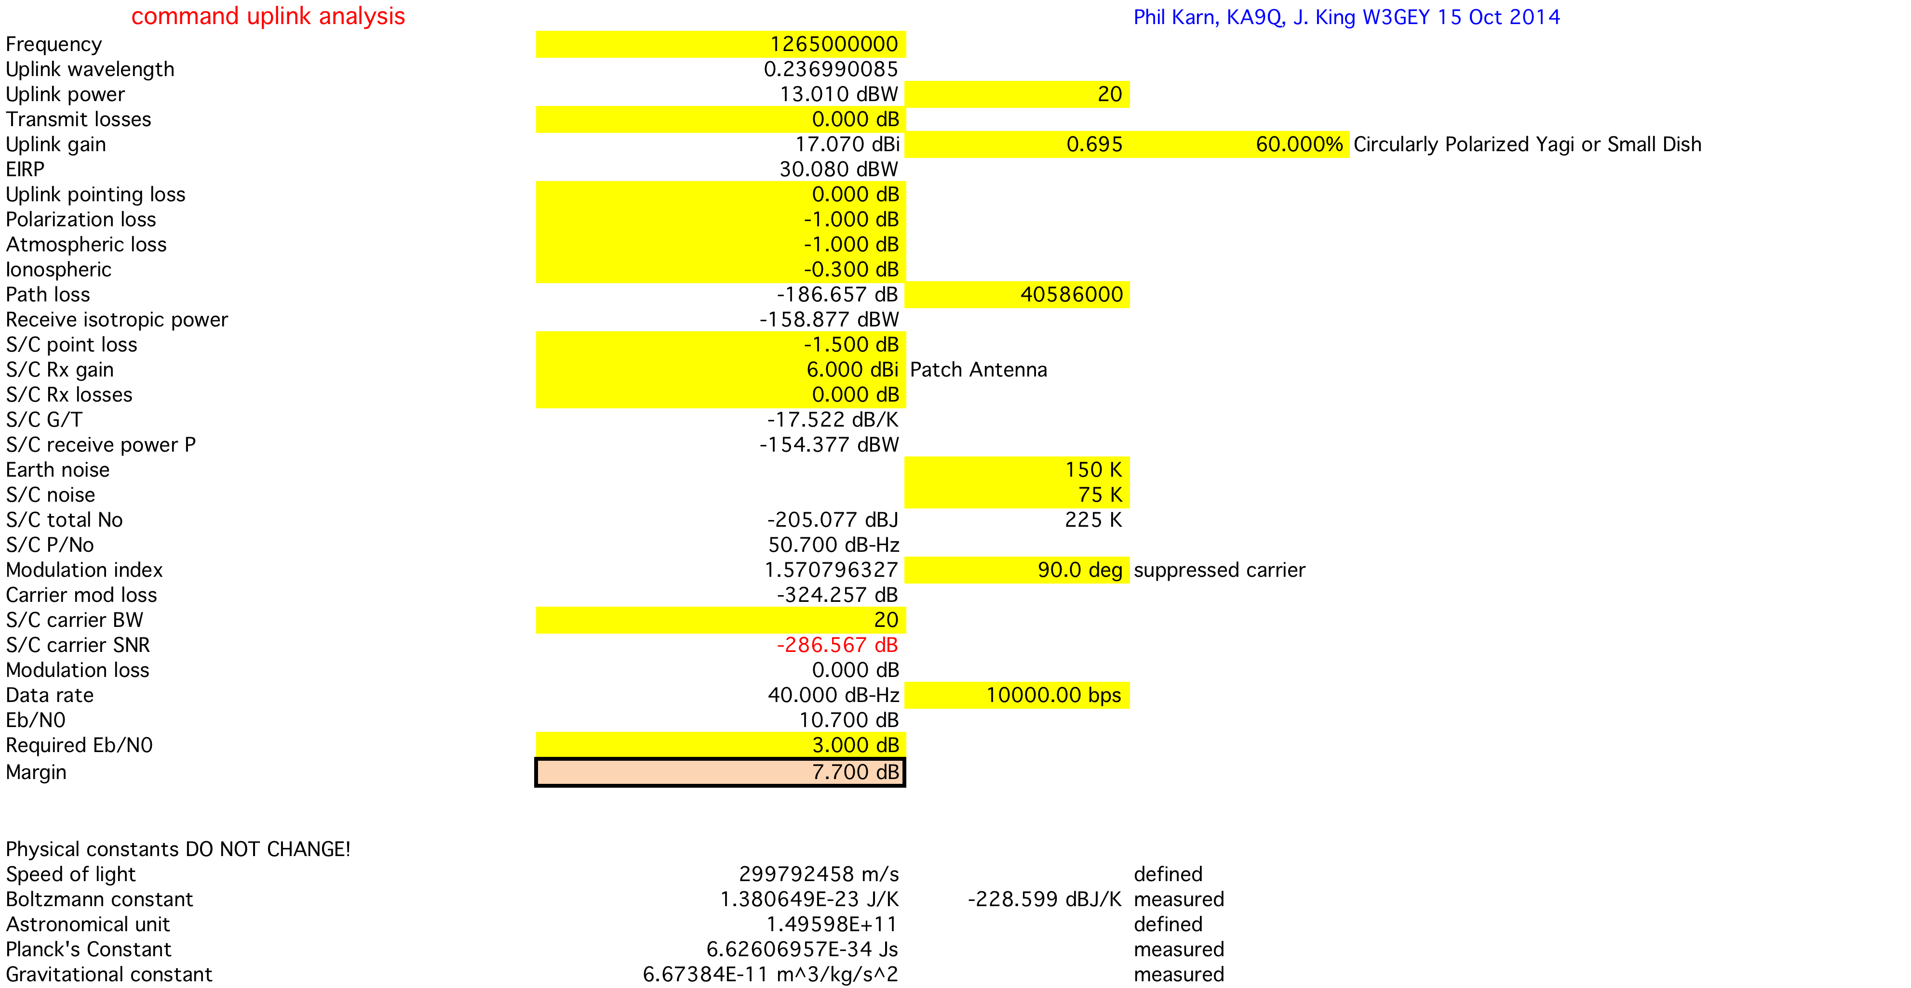
CMD Link Budget
(@Apogee; Elevgle = 10°)
C

Slide 38
RadFx Experiment Vanderbilt University
Vanderbilt researchers are investigating the SEU sensitivity of carefully selected digital devices.
Models developed will allow estimates of the cross sectional area of a single device cell for protons capable of generating SEUs.
SEUs will be evaluated as a function of supply (bias) voltage and orbit radiation inputs.
The RadFx unit is a copy of that being flown in 2015 on the Fox-1 Cubesat.
The radiation environment, however for GTO is quite different. (See Feasibility Rev.)
Figure 5. Simulated and experimental proton cross sections
of a 65 nm SRAM cell. Model provides good agreement at high
energy and captures the steep increase in cross section at low energy.

Slide 39
Precipitation Attenuation Experiment Vanderbilt, Department of Atmospherics
Experiment will Measure the Attenuation of a Special Beacon provided by the mmW Transponder on its Downlink Path. Careful Calibration of Amplitude and Phase Noise measurements will be made of this beacon prior to launch.
The power level of the beacon will be adjustable by ground command (from a level of +3o dBm to 0 dBm) Amplitude level will be measured, recorded, time-tagged by the IHU for subsequent TLM downlink.

Slide 40
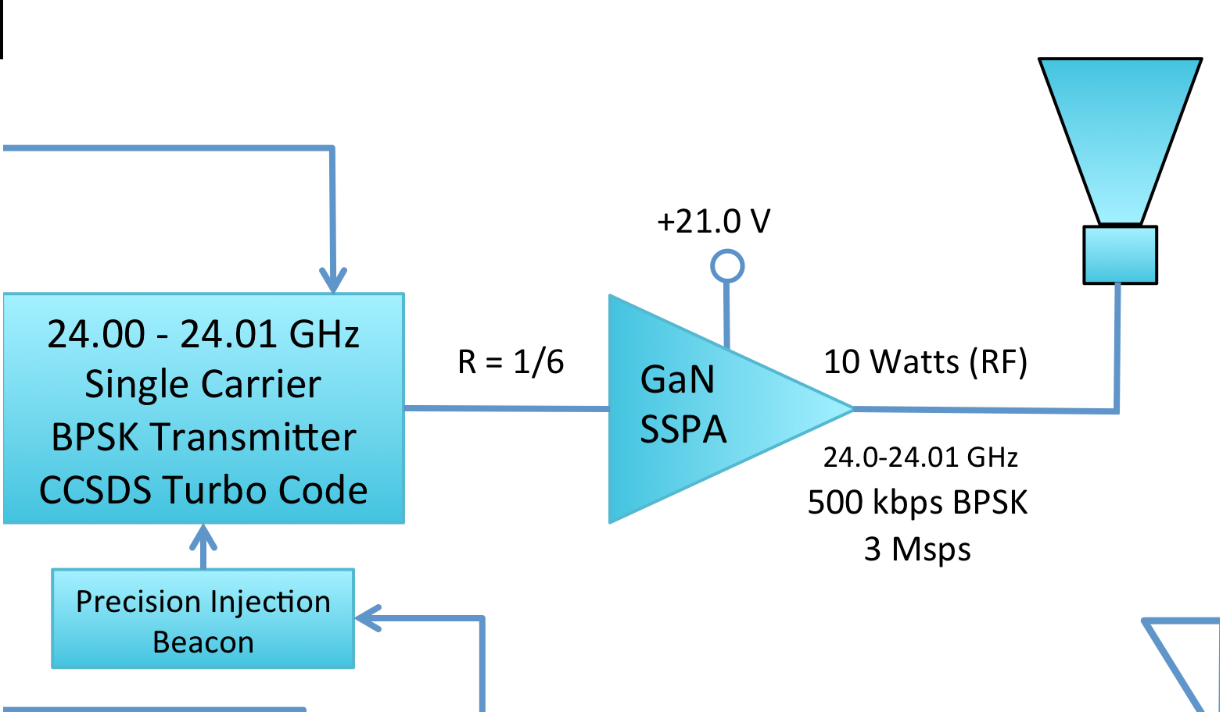
Precipitation Attenuation Experiment
(Delivering wireless power as an experiment)
IHU Beacon Control
Precision Injection
Beacon
Transponder Downlink
Modulation Limit (10 MHz)
22.800 – 24.000 GHz
(TBD)
24.001 GHz
24.01 GHz

Slide 41
EP
Utilizing a synchronization system from patent number 10006445
VAT (vacuum arc thruster) micro-propulsion subsystem is an outgrowth of GWU Micropropulsion and Nanotechnology Laboratory (MpNL) research. NASA TRL 8 flight hardware, tested on orbit, BRICsat-P 2015, and Canyval-x 2018.
The technology here will be used in two mission-critical phases
Perigee raising and maintenance and orbit adjustment
Mission Termination (By lowering perigee at EOL)
Total ΔV Requirement is approximately 75 m/sec
31 m/sec for perigee raising
44 m/sec (or less) for mission termination
An array of thrusters will be employed in Off-Pulse mode to control attitude during the active maneuver.

Slide 42
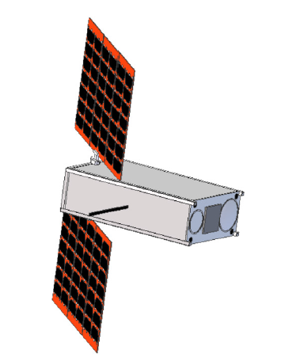
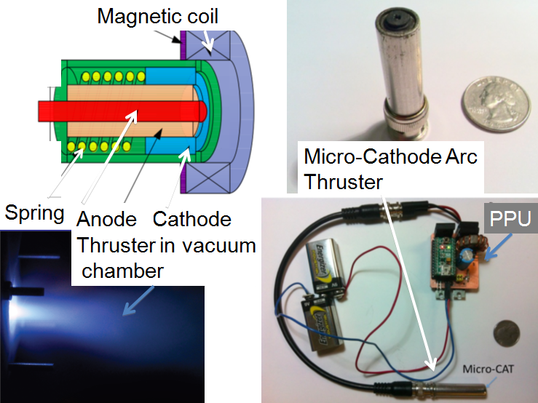
EP
Thruster dangerous! Do
not stand behind it!
Typical of 4 Units

Slide 43
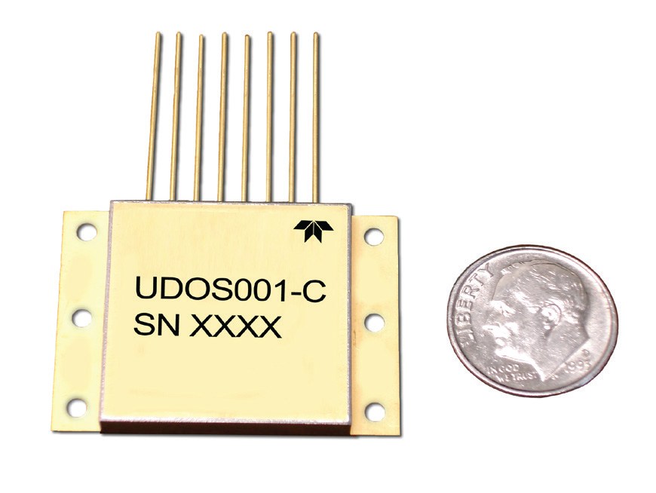
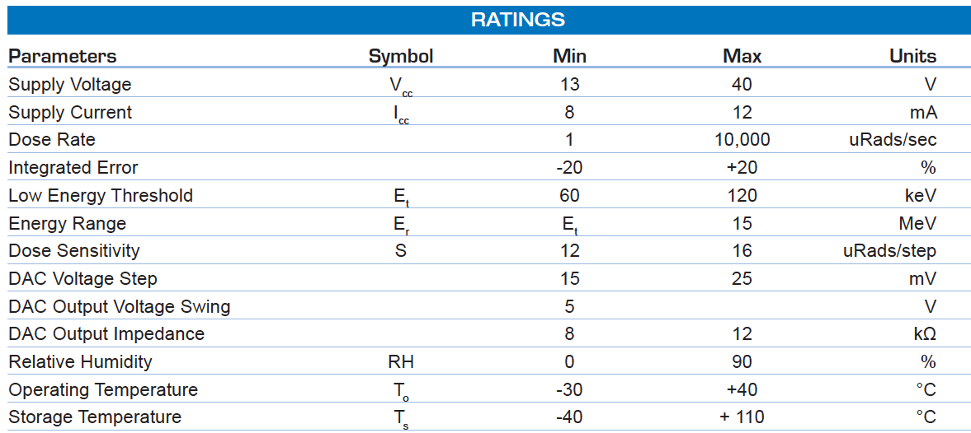
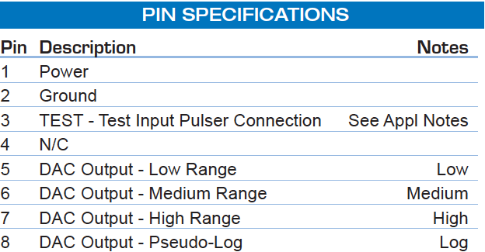
Total Integrated Dose (TID) Radiation Monitor (AMSAT-NA)
Teledyne TID device will be flown to continuously monitor the in-flight cumulative dose.
Unit selected has a wide range of dose-rate settings.
Interface to S/C via A/D and I²C Telemetry Bus. Simple analog output.

Slide 44
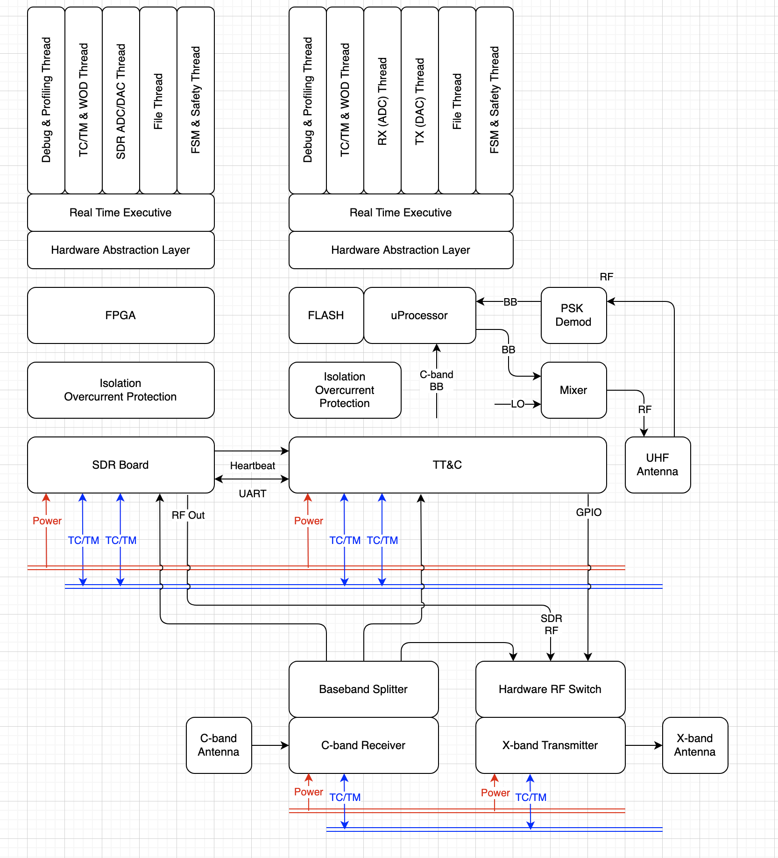
Interfaces

Slide 45
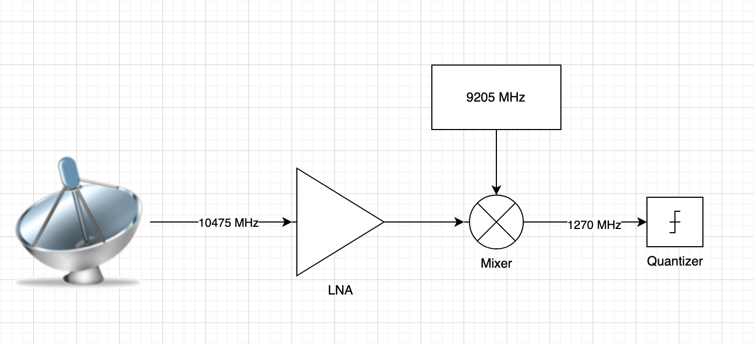
RF Plan

Slide 46
System Architecture
Hardware State Table reviewed
Initial reliability trade document reviewed
Interface Diagram reviewed
Payload Interface declared
Use Cases, User Experience, User Interface begun

Slide 47
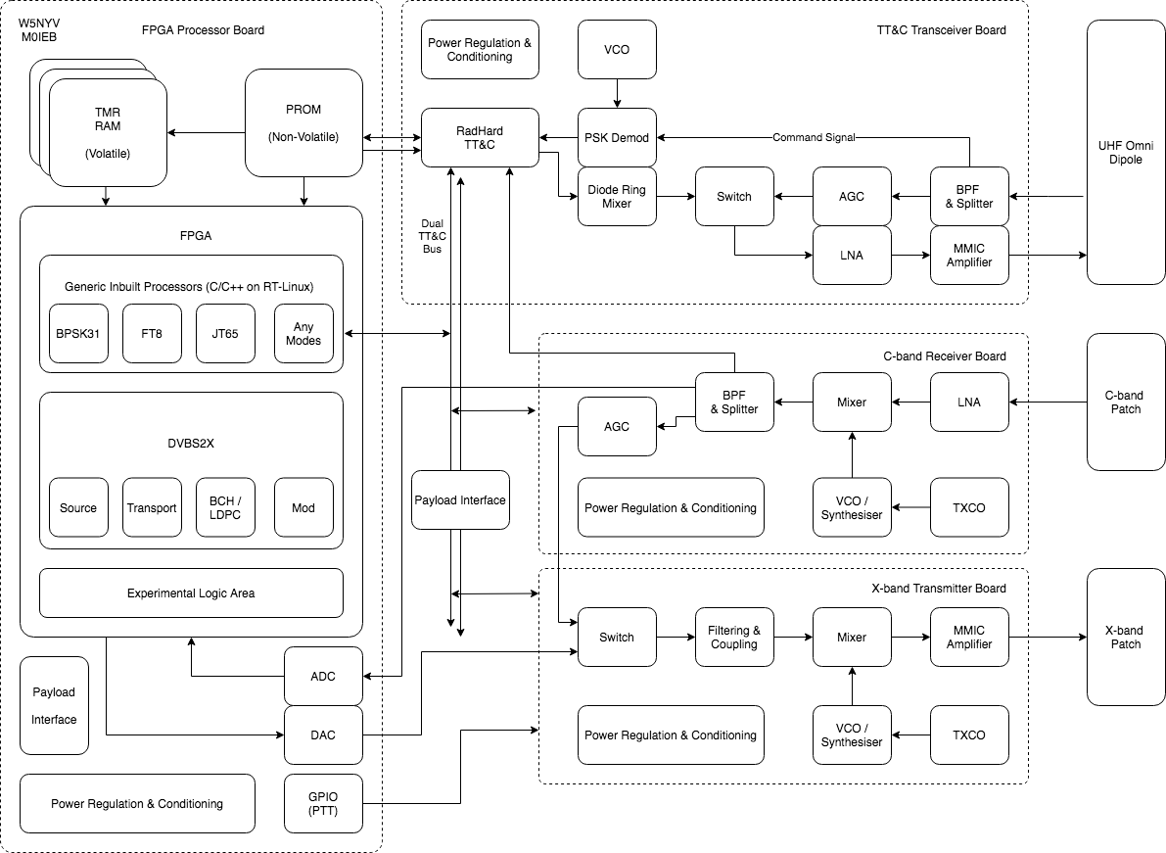

Slide 48
UHF Transponder
(in event of failure)
Command TT&C
To all HW units
FPGA Processors ARM (Xil, Actel)
Existing OS Code ✔️
C-b Transponder
(in event of digital failure)
FPGA SDR Board
“Looks like” AstroSDR, Pluto = MK1
Existing P4 Code ✔️

Slide 49
TT&C Switch
Tx X-band Switch

Slide 50
UHF Transponder
(in event of failure)
Command TT&C
To all HW units
FPGA Processors ARM (Xil, Actel)
Existing OS Code ✔️
C-b Transponder
(in event of digital failure)
FPGA SDR Board
“Looks like” AstroSDR, Pluto = MK1
Existing P4 Code ✔️
Losses!

Slide 51
Proposed
Architecture
TRL Path
What exists?
What mission opportunities?
Green = available / qualified now
Yellow = circuits
Believed to be
Used on other
Missions. Red = high risk
ESA LUCE (2022/23)
Phase 4 + QO-100
OrigamiSat-1 5.84 GHZ DL
FITSAT-1 5.8 GHz DL, 115.2kbps + visible light CW
Antenna
Source?
FUNcube-LX X-band transmitter (2021/22)

Slide 52
Hardware States = RF Switch States
State | TT&C | Rx C-band | Tx X-band | SDR
Transponder | 0 (Unpowered, default) = UHF Transponder | ON | 0 (Unpowered, default) = X-band Transponder | N/A
Digital Mode | 0 (Unpowered, default) = UHF Transponder | ON | 1 = SDR Input | Default Output (File-based Ops)
Transponder + UHF Telemetry | 1 = TT&C Active | ON | 0 (Unpowered, default) = X-band Transponder | N/A
Digital Mode + UHF Telemetry | 1 = TT&C Active | ON | 1 = SDR Input | Default Output (File-based Ops)
SDR has preloaded Default Directory with Control.txt & IQ Files of each test mode (e.g. FT8.uint16.raw)
Control.txt ASCII file is edited by TT&C Command to add/remove IQ files for transmission
= Low data method to control SDR output

Slide 53
Interfaces (Detail)
TT&C System is a ‘Intelligent’ Router
Sample, receive, decode, route incoming packets / frames to all systems (& the reverse too)
Collect telemetry to make local Safety Decisions with Updatable Defaults
E.g. HPA is too hot, or timer default values need updating to new values
TT&C Bus needs to be Multi-Master , Hot Swappable & Low Power
Multi-master means TT&C can control / drive switches & payload state
Hot Swappable means systems can be plugged / powered in or out (in testing, through failure, etc)
AND SDR FPGA can do the exactly same = Fast & Flexible Design
Interface should be reusable where possible (mech, elec, software)

Slide 54
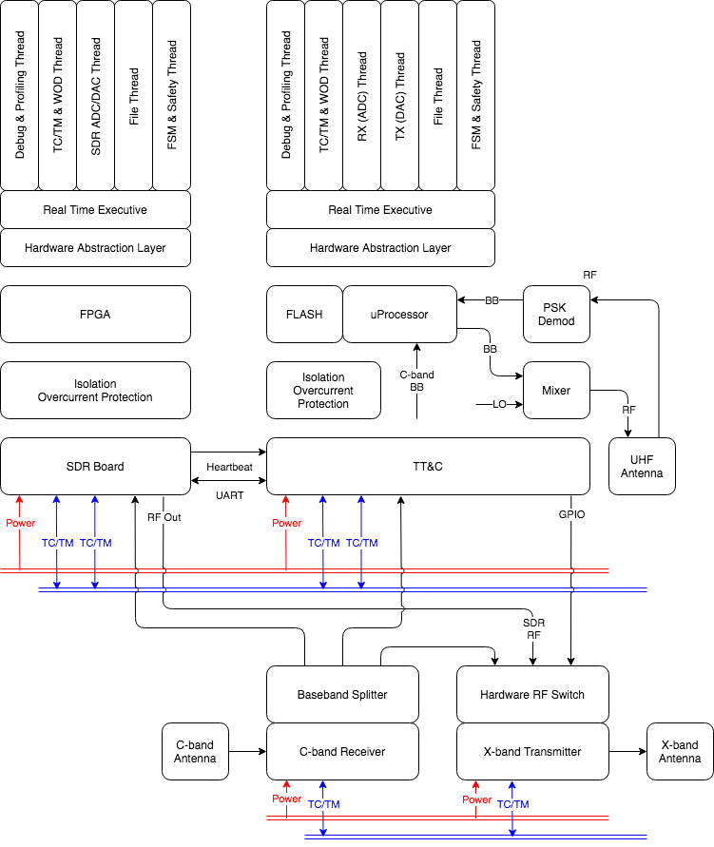
Interface
Diagram
TT&C will be collecting Telemetry (TM) & running a Finite State Machine (FSM) to manage Switches & GPIO
Transmit ON / OFF (essentially a PTT GPIO line) for Safety & ITU
SDR UART goes from 1k2 > 115k2 to 1) Operate Command Line & 2) Transfer Files
SDR Heartbeats are GPIO ON / OFF pulses that if stopped indicate error. FSM manages attempts to reset.

Slide 55
Fault Detection, Isolation & Recovery (FDIR)
Concept must cover both Digital & Analogue Electronic Systems
Undesired Effects (non-exhaustive) | Mitigation Strategies
Single Event Upsets, Transients, Glitches = Software Recoverable | SW Heartbeats & Watchdogs (between ANY clocked processor) TMR (FPGA SDR) Scrubbing (FPGA SDR, Volatile Memories) Error Correction & Detection (ANY read / write possible, e.g. BCH)
Digital Latchups, Switching / Interfacing, Power Fluctuations = Semi-Recoverable | H/W Heartbeats Isolation & Filtering Circuitry / Differential Signals for Bus Cross-strapping (e.g. Dual Bus Configuration) Power Cycling
Total Ionising Dose (TID) Gate Burnout / Rupture, FLASH write cycles = Non-recoverable | Part Selection (NASA / ESA / Heritage Parts) Redundancy (based on Critical Path) Design for ‘Graceful Degradation’ Testing & Validation > Evidence-led Decision Points

Slide 56
Camera Options
SDR FPGA has Payload Interface
Tightly Coupled, can only operate when SDR FPGA is in operation
Power Modes also coupled
Likely to be fast
SDR FPGA Testing coupled with Camera
Camera has own TT&C Bus Interface
Decoupled, but needs additional interface & processing circuit
Flexible to power / mode requirements
Likely to be slower
Camera needs independent testing

